Slide 1
MINI PROJECT PRESENTATION
Presentation By:
Avani Singh
Shilpy Raghav
Shoyab Alam Idrisi
Supervised By: Ruchi Gupta

Slide 2
PROJECT Title
SECURE PUBLIC GRIEVANCE
PORTAL AND COUNSELLING CENTER

Slide 3
TEAM INTRODUCTION
AVANI SINGH (171500068)
B. Tech CSE
Year - III
Section - A
SHILPY RAGHAV (171500316)
B. Tech CSE
Year - III
Section – A
SHOYAB ALAM IDRISI (171500327)
B. Tech CSE
Year - III
Section - E

Slide 4
PROBLEM STATEMENT
A social issue is anything that influences many individuals within the society. The major social issues in our country like population, environmental imbalance, domestic violence, harassment, drug abuse, sexual abuse and many more which cannot be counted over our fingers. There are many people striving to solve these problems and many more who step back to these problems due to nature of the government and fear of Police-case.

Slide 5
Objective
Secure Public Grievance Portal and Counselling Centre is a platform where anyone can register complaints regarding any social issues without revealing his identity.
The complaint lodger will be provided with a satisfactory help.
It aims to develop a working portal where people can lodge social-complains and get counselling and justifiable guidance from authorized experts.

Slide 6
SCOPE
The increase in the social issues and being traditional most of the people hesitate to some forward and lodge any kind of complain regarding the social grievances.
This website will provide them a platform to raise their voice and get proper help.
We have user, admin and counsellor section in our website.
The user lodges the complaint and it is made visible to the counsellors and on the basis of the problem they provide feedback which will be helpful for the lodger.

Slide 7
PROJECT SUMMARY
Secure Public Grievance Portal and Counselling Centre is a full-stack based project.
Main aim is to develop a working portal where people can lodge social-complains and get counselling and justifiable guidance from different authorized experts.
The different social grievance situation may vary for domestic violence to corruption including child marriage, child labour, environmental issues and illiteracy.

Slide 8
requirements
Hardware:
RAM required- 8 GB or above
Processor- core i3 or above
Software:
Linux
MySQL
Apache5
Brackets
Technology Used:
HTML
CSS
PHP
JavaScript
SQL

Slide 9
WEB Development
Web development is the work involved in developing a web site for the internet or an intranet.
Comprehensive list of, may include web engineering, web design, web content development, client liaison, client- side/server-side scripting, web server and network security configuration and e-commerce development.
It is the coding or programming that enables website functionality as per the owner's requirements.
Web developers now help to deliver applications as web services which were traditionally only available as applications on a desk-based computer.

Slide 10
Website
A website refers to a central location that contains more than one web page or a series of web pages.
The first website was built at CERN by Tim Berners-Lee and launched on August 6, 1991.
As of January 2018, depending on which survey or hosting company being referenced, there are between 1.3 and 1.8 billion websites on the Internet.

Slide 11
USER INTERFACE DEVELOPMENT
HTML
CSS
JavaScript

Slide 12
Backend
PHP
Created by Rasmus Lerdorf in 1994 and publicly released on June 8, 1995.
PHP, is a server-side interpreted scripting language.
It was designed for creating dynamic web pages and web pages that effectively work with databases

Slide 13
The Secure Grievance Portal
Admin Portal
Admin can view complete complaint status and information.
Counsellor Portal
Counselor can view different complaints and entertain them according to their field and provide feedback accordingly.
User Portal
User can lodge complaint and can keep follow up on that.
Admin and counsellor will try their best to help the user either by providing feedback or by contacting them in serious issues.

Slide 14
SPECIFICATIONS
In this portal we have categorized the social problems into different categories like child labour, sexual harassment, Environmental problems, domestic violence and adult illiteracy.
After the user get registered, he steps forward to lodge a complaint.
The complaints are stored in a complain box and the counsellor can fetch the list and provides the valuable feedback.
The feedback is shown to the user page and on behalf of that he provides some suggestions if any needed.
After the completion of a complaint the counsellor can change the status of the complaint. The status is changed to close.

Slide 15
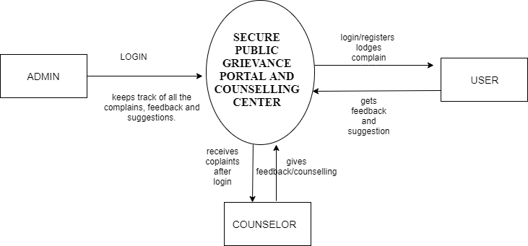
DATA FLOW DIAGRAM

Slide 16
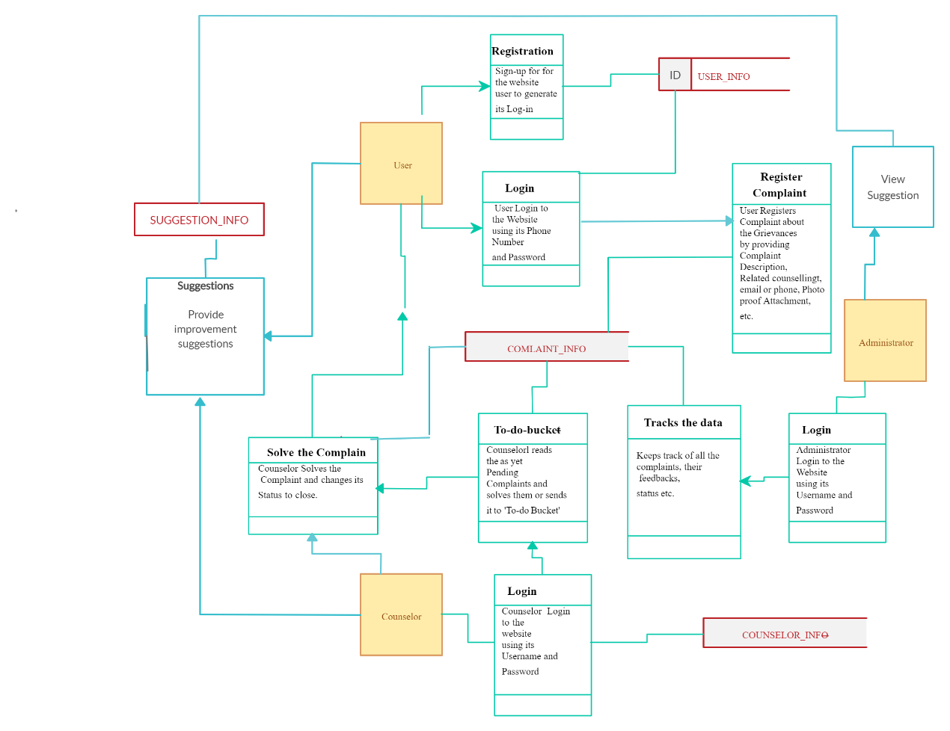
CLASS DIAGRAM

Slide 17
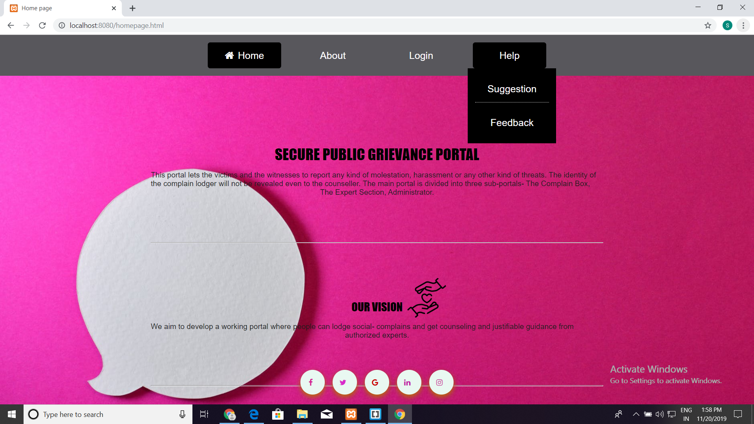
HOME PAGE

Slide 18
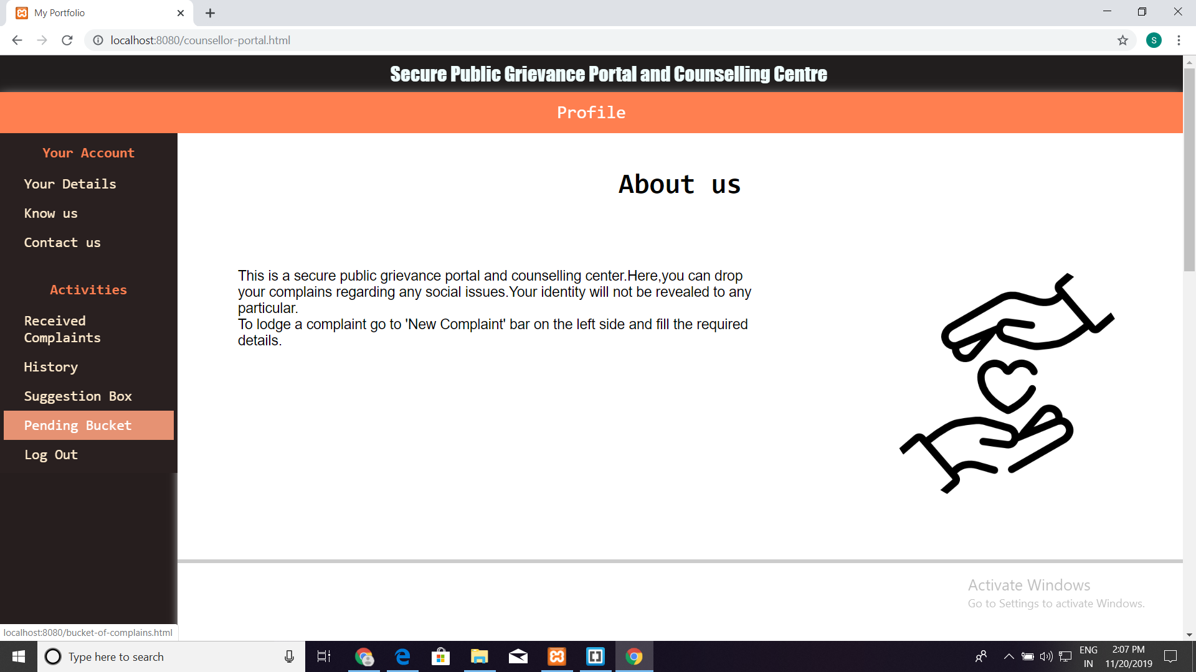
PORTAL

Slide 19
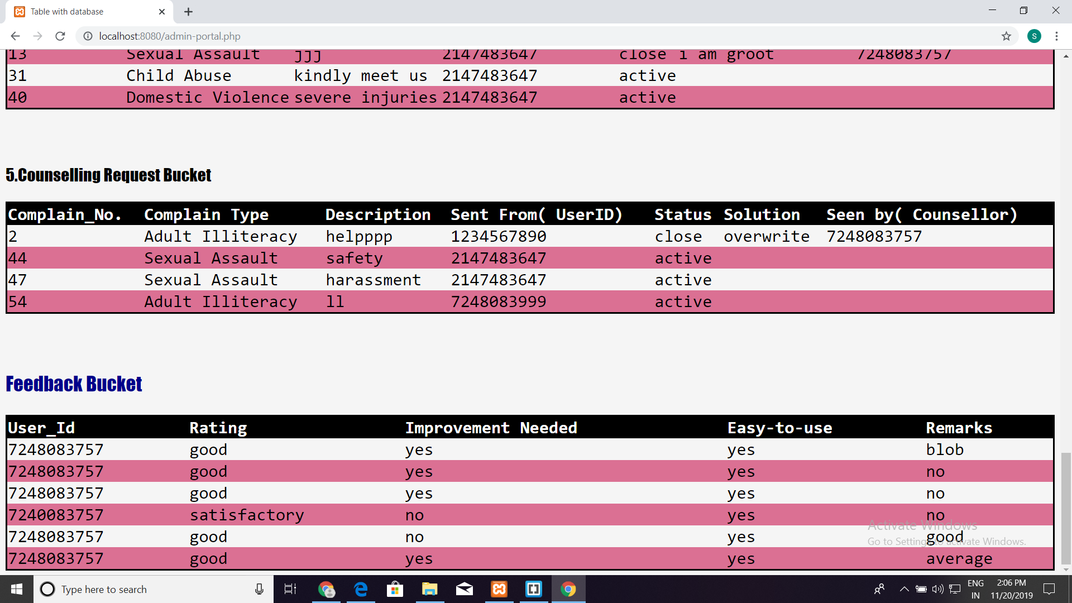
Fetched Data

Slide 20
Future Prospects
The portal can be extended to cover a wide range of intra-organizational as well as extra-organizational issues
User accounts can be created through registrations and an account-to-account chat facility can be provided.
An application can be develeped foe the same idea.
Online communities can be created to solve a problem completely.
Location tracking facility in case of emergency.

Slide 21
CONCLUSION
After the successful completion of this project we have developed a solution for the most common but a complicated problem. This solution will help the user to lodge complains regarding the social issue which he notices but hesitates to register that complain to any place. Through this portal the user can lodge a complain without revealing the identity. We provide different type of support according to the problem reported.

Slide 22
References
www.wikipedia.org
www.stackoverflow.com
www.google.com
www.javatpoint.com

Slide 23
THANK YOU ☺

